Slide 1
Amazon Stock Analysis
File created on: 6/10/2022 10:30:24 AM

Slide 2
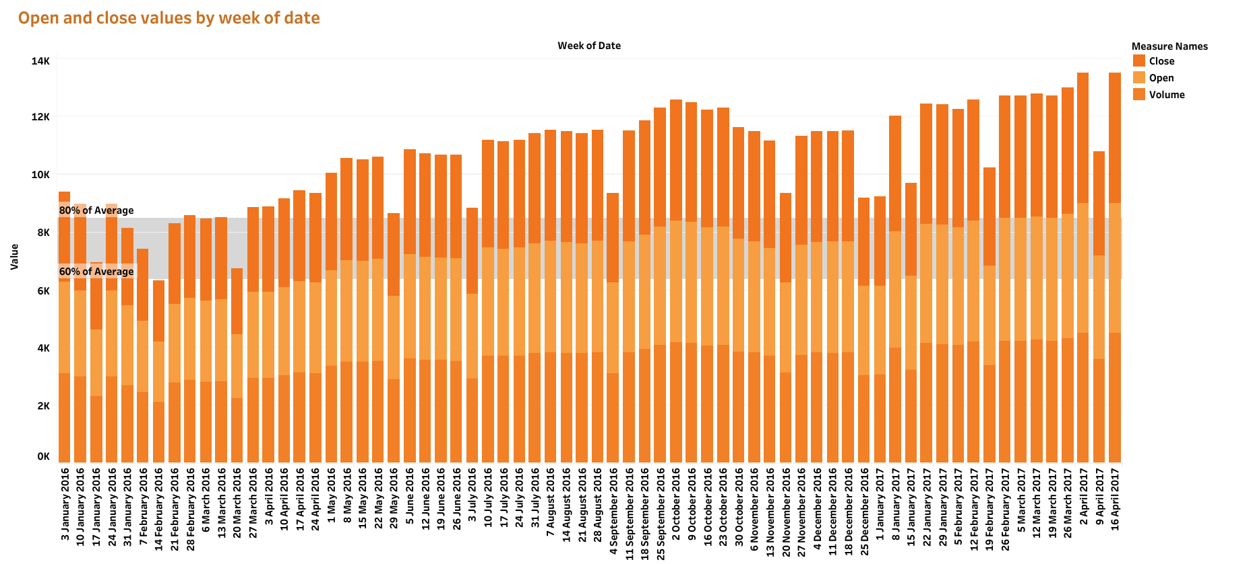

Slide 3
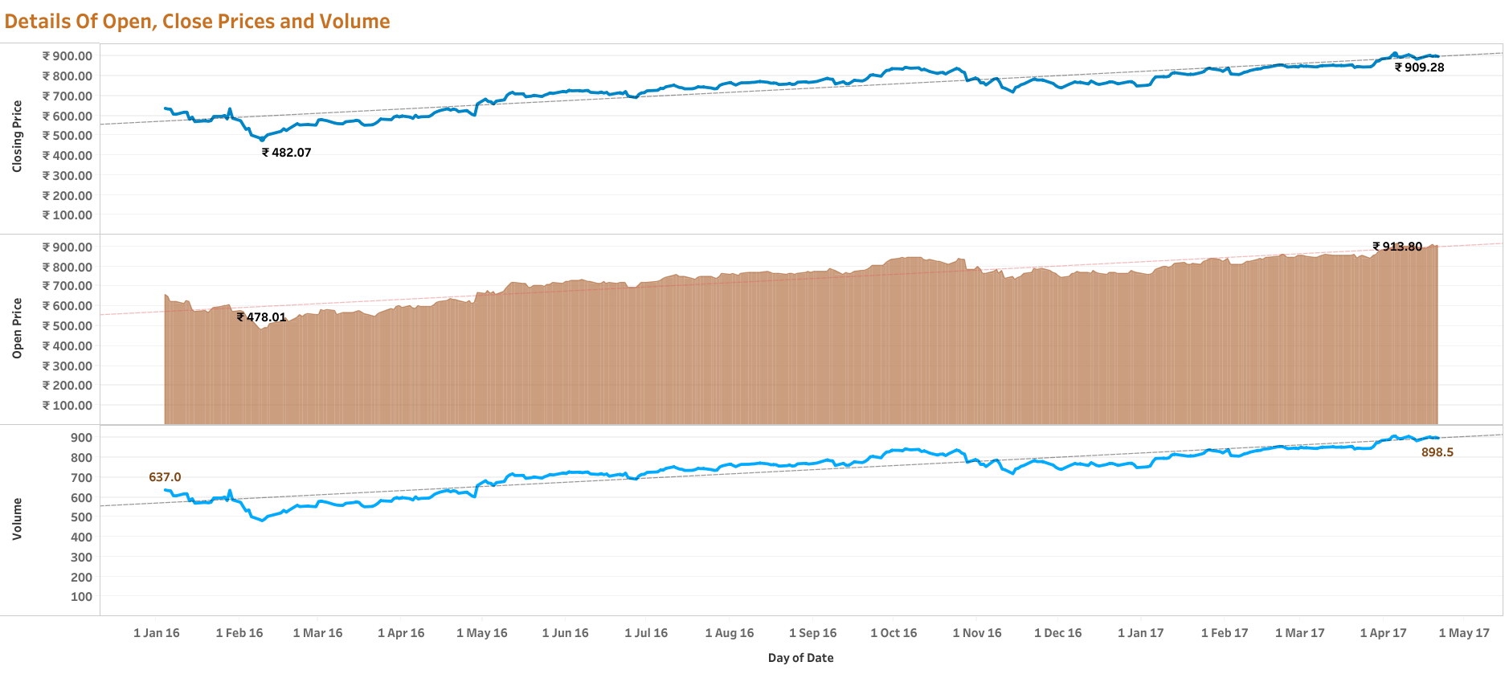

Slide 4
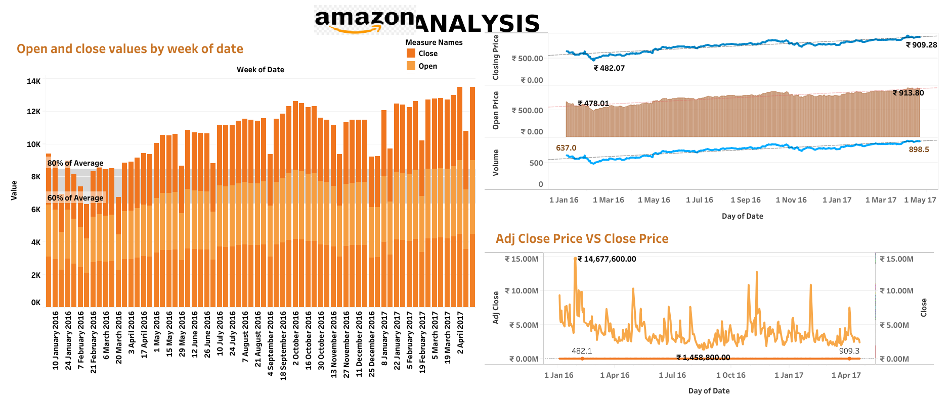

Slide 5
